Slide 1
COS 214 Project Report
Lazy Robots

Slide 2
Agenda
Introduction
Game Description
Implementation
Process flow
Pre-initial UML Design
Final Design

Slide 3
Group Members
Tiyego Emito Khoza
Sovaria Naidu
Mduduzi Sibiya
Ezekiel Makau
Emmanuella Birato

Slide 4

Introduction
War is a conflict between two or more parties, the kind of conflict fought with weapons over territories. Our solution to simulating this is through the concept of board games because everything about war can be described using a board game

Slide 5
Game Description

Slide 6
Node
The Node wars is a turn-based war board game. The board the game will be played on will be a graph data structure and the pieces moving on it are the army units.
Army units
Tank units
Attack helicopter units
Infantry units
Supply units

Slide 7
Army units
Units | Health | Damage | Travel speed | Range
Tank Units | 100 | 50 | 1 node/turn | 1 node away
Attack Helicopter units | 50 | 50 | 2 nodes/turn | 2 nodes away
Infantry units | 150 | 30 | 1 node/turn | 0 nodes away
Supply units | 300 | 10 | 2 nodes/turn | 0 nodes away

Slide 8
Each player will control its own country and have a turn to make armies, give existing army units on the battlefield, to surrender and end their turn.
“
”

Slide 9
Player Commands
•Move to the next node
Attack a unit in a node
•Supply neighboring units

Slide 10
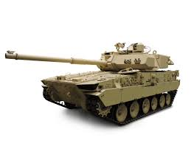
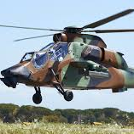
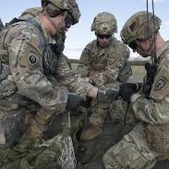
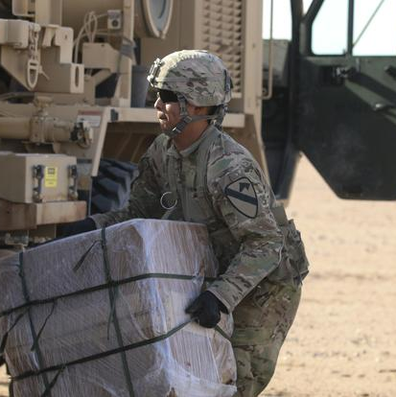
Request each Player can make
Make Tank units (150)
Make Attack Helicopter (200)
Make Infantry units (100)
Make Supply units (150)

Slide 11
Flag
The player can surrender, which essentially changes their current flag to a white flag, and they are taken out of the war.

Slide 12
Implementation

Slide 13
Types of terrain:
Plain terrain (No effects)
Mountain terrain (slows down helicopters)
Forest terrain (decreases helicopter damage)
Swamp terrain (slows down units except flight units)

Slide 14
Process flow
user would be prompted to create players
user would be prompted to create players
WarEngine class will create the graph
Load default map
Creating player
Creating player
Country created
Money allocated = 1500
Country created
Money allocated = 1500

Slide 15
Final Design
An efficient creation of different types of army units
A country to be able to give commands to their troops, whether it’d be attacking, supplying, moving or surrendering
A simple interface for the user to interact with
Since a node is a territory, it’s terrain should affect the army units that occupy it
There should be different types of terrains
We should be able to tell if a country is still active in war or if they’ve surrendered their flag
Management of the financial resources used by the country to fund their army unit creation

Slide 16
Thank you
Mirjam Nilsson​
mirjam@contoso.com
www.contoso.com

